Slide 1
Conceptual Modelling and Data Warehouse Design

Slide 2
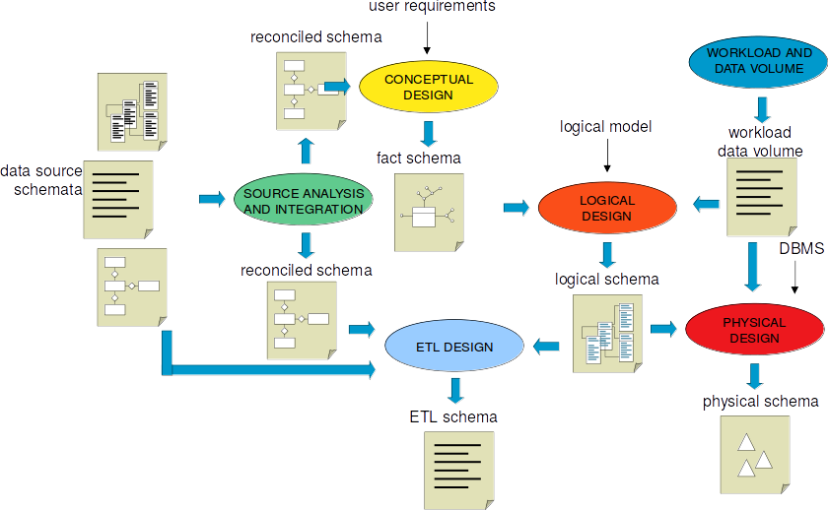
Supply-driven (Data-driven) DM Design

Slide 3
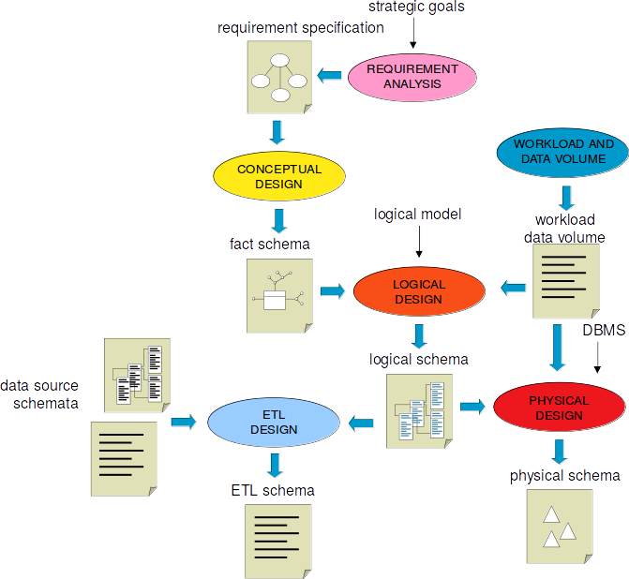
Demand-driven (Requirement-driven) DM Design

Slide 4
Data Warehouse Process
From a functional point of view, the data warehouse-process consists of three phases:
The first phase encompasses typical issues concerning distributed heterogeneous information integration, such as inconsistent data, incompatible data structures, data granularity, etc., … ETL
The second phase, encompasses typical issues concerning the conceptual design of a DWH. DWH design requires techniques completely different from those adopted for operational information systems.
The third phase requires capabilities of aggregate navigation, optimization of complex queries, friendly visual interface to be used for On-Line Analytical Processing (OLAP) and data mining.

Slide 5
Conceptual DWH Design
Is now universally recognized that a DW is based on a multidimensional view of data: But there is still no agreement on HOW to implement its conceptual design !
Most of the time, DW design is at the logical level : a multidimensional model (star/snowflake schema) is directly designed :
But a star schema is nothing but a relational schema: it contains only the definition of a set of relations and integrity
constraints !
A better approach:
1) design first a conceptual model : Conceptual Design
2) which is then translated into a logical model : Logical Design

Slide 6
Conceptual Design of a DWH
Important Issues
Conceptual models represents real-world concepts, not logical models or software components.
Conceptual models identify the main domain concepts and their associations.
Conceptual models are usually mapped to a logical model (i.e. relational, object oriented, XML… and so on)

Slide 7
Conceptual Design of Data Warehouse
The conceptual design of a DW produces a dimensional scheme. A dimensional scheme consists of a set of fact schemes.
The basic components of a fact schemes are fact, dimensions and hierarchies.
A fact is a focus of interest for the enterprise;
A dimension determines a point of view adopted for representing facts;
A hierarchy determines how fact instances may be aggregated and selected significantly for the decision-making process.

Slide 8
Classifying Entities
The first step in producing fact schemes from ER model is to classify the entities into 3 categories: transaction entities, component entities and classification entities.
Transaction entities. Transaction entities record details about particular events that occur in the business. The events that decision makers want to understand and analyse.
EX: orders, insurance claims, salary payments and hotel bookings.
Key characteristics of a transaction entity:
It describes an event that happens at a point of time.
It contains measurements or quantities that may be summarized.
EX:
an insurance claim records a particular business event and the amount claimed.
A sale records an event that relates a product sold in an order and the sum of amount and the number of units sold.

Slide 9
Component Entities
A component entity is one which is directly related to a transaction entity via a one-to-many relationship. Component entities define the details or “components” of each business transaction.
Component entities answer the “who”, “what”, “when”, “how” and “why” of a business event.
EX: a sales transaction may be defined by a number of components:
Customer: who made the purchase.
Product: what was sold.
Location: where it was sold.
Period: when it was sold.
An important component of any transaction is time - historical analysis is an important part of any data warehouse.
Component entities form the basis for constructing dimensions in fact schemes.

Slide 10
Classification Entities
Classification entities are entities which are related to component entities by a chain of one-to-many relationships.
They are functionally dependent on a component entities (directly or transitively).
Classification entities represent hierarchies enbedded in the fact schemes, which may be collapsed into component entities to form dimensions in the fact schemes.
EX: store, city, sales-manager, type, category

Slide 11
Modeling Design Process
Identify the Business Process
Source of “measurements”
Identify the Dimensions
Descriptive context, true to the grain
Identify the Facts and Measures
Numeric additive measurements, true to the grain

Slide 12
Dimensional Fact Model (DFM)
The conceptual design of a DW produces a dimensional scheme, structured according to the Dimension Fact Model (DF model). A dimensional scheme consists of a set of fact schemes.
The basic components of a fact schemes are facts, dimensions and hierarchies.
A fact is a focus of interest for the enterprise;
A dimension determines a point of view adopted for representing facts;
A hierarchy determines how fact instances may be aggregated and selected significantly for the decision-making process.

Slide 13
A fact scheme
A fact scheme is structured as a tree whose root is a fact.
The fact is represented by a box which reports the fact name and, typically, one or more numeric attributes which "measure" the fact from different points of view.
Each vertex directly attached to the fact is a dimension.
Figure 1 reports a fact scheme for fact SALE in a store chain; quantity sold and returns are fact attributes.

Slide 14
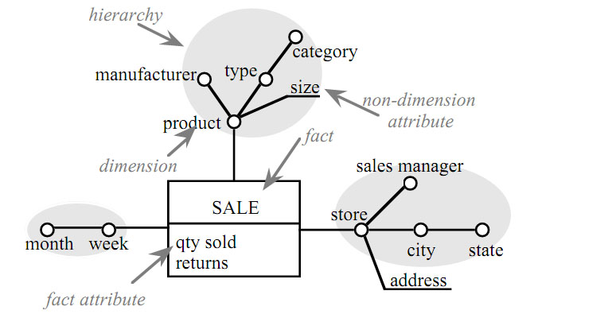
Fig 1. A simple fact scheme for a chain of stores

Slide 16
A fact instance
A fact expresses a many-to-many relationship among dimensions.
Each combination of values of the dimensions defines a fact instance; fact instances are the elemental information with the DW.
EX: a fact instance describes “the quantity of one product sold during one week in a store, and the corresponding total returns”.
A fact scheme may also have no fact attributes. [Factless fact table]

Slide 17
Hierarchies
Subtrees rooted in dimensions are hierarchies. Their vertices, represented by circles, are attributes which may assume a discrete set of values; their arcs represent x-to-one relationships between pairs of attributes.

Slide 18
Hierarchies
The dimension in which a hierarchy is rooted defines its finest aggregation granularity; the attributes in the vertices along each sub-path of the hierarchy starting from the dimension define progressively coarser granularities.
The fact scheme in Figure 1 has three dimensions: week, product and store.
Some terminal vertices in the fact scheme may be represented by lines instead of circles (size and address in Figure 1); these vertices are non-dimension attributes.

Slide 19
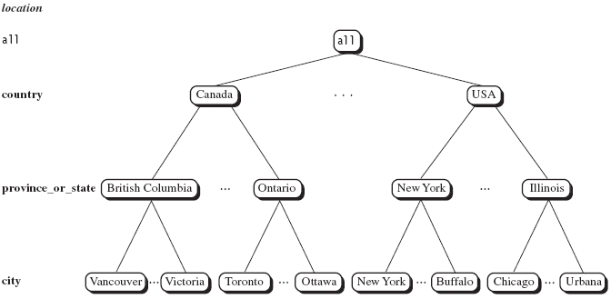
Dimensions and Concept Hierarchies

Slide 20
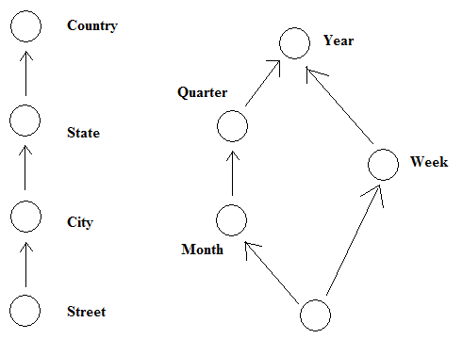
Concept Hierarchies
Many concept hierarchies are implicit within the database system

Slide 21
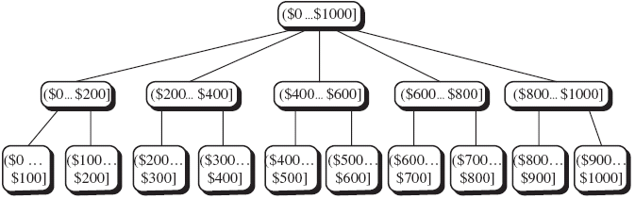
Concept Hierarchies
Concept hierarchies may also be defined by grouping values for a given dimension or attribute, resulting in a set-grouping hierarchy

Slide 22
DFM-Hierarchies

Slide 23
Shared Hierarchies
Shared hierarchies exist when entire portion of hierarchies are frequently replicated 2 or more time in fact schemata
In particular in time hierarchies, 2 or more date-type dimensions with different meaning can easily exist in a same fact, and need to build a month-year hierarchy on each one of them
=> an abreviation is introduced
Ex: calling and called phone numbers …callingNumberType

Slide 24
Convergence
A convergence takes place when 2 dimensional attributes within a hierarchy are connected by 2 or more alternative paths of many-to-one associations (Graphically, use of arrows).
Ex : in store dimension, store are grouped into sales districts and no inclusive relationship exists between districts and states, but each district is part of only one country:
Store -> salesDistrict -> country
or
Store -> storeCity -> state -> country
convergence

Slide 25
Overlapping compatible fact schemes
Different facts are represented in different fact schemes.
The queries the user formulated on the DW may require comparing fact attributes taken from related schemes.
Two fact schemes are said to be compatible if they share at least one dimension attribute. Two compatible schemes F and G may be overlapped to create a resulting scheme H.
In the simplest case:
The set of the fact attributes in H is the union of the sets in F and G.
The dimensions in H are the intersection of those in F and G; assuming that a given dimension is common to F and G if at least one dimension attribute is shared.
Each hierarchy in H include all and only the dimension attributes included in the corresponding hierarchies of both F and G.

Slide 26
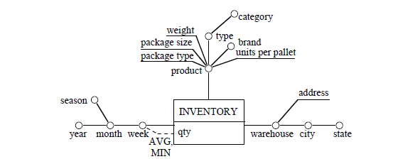
Inventory- DFM
..... both operators AVG and MIN can be used for aggregation; measure qty expresses, for each product, the number of copies present within each warehouse during each week

Slide 27
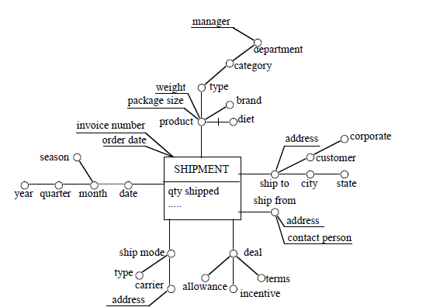
Shipment DFM
..... Shipment and Inventory are overlapping facts...can be merged to one scheme!!!

Slide 28
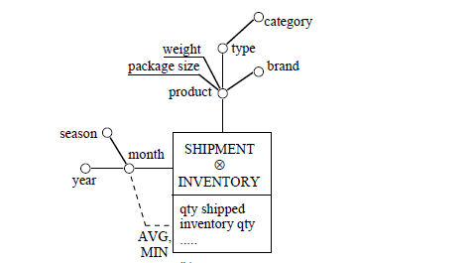
Merged Inventory-Shipment DFM

Slide 29
Conclusions
Conceptual Data warehouse Design (CDW)
DFM Model
Next time from CDW→LDW (L=Logical)

Slide 30
Lets Put things in Practice-Review Tutorials 1,2,3

Slide 31
heterogeneous information integration-Phase OneFunctional Dependencies
X → Y Therefore X is the primary key
In Practice…..
FLIGHTS(flight-Number, airline, From-Airport: AIRPORTS, To-Airport: AIRPORTS, departure Time, arrivalTime, carrier)
flight-Number → airline, From-Airport, To-Airport, departure Time, arrivalTime, carrier
FLIGHT_INSTANCES (Flight-Number: FLIGHTS, date)
Flight-Number, date →Flight-Number, date
AIRPORTS (IATA-Code, name, city, country)
IATA-Code → name, city, country
TICKETS (Ticket-Number, FlightNumber: FLIGHT_INSTANCES, fare, passengersFirstName, passengersSurname, passengersGender)
Ticket-Number→ FlightNumber, fare, passengersFirstName, passengersSurname, passengersGender
CHECK-IN (Ticket-Number: TICKETS, Check-in-Time, Seat, numberOfBags)
Ticket-Number, Check-in-Time → Seat, numberOfBags

Slide 32
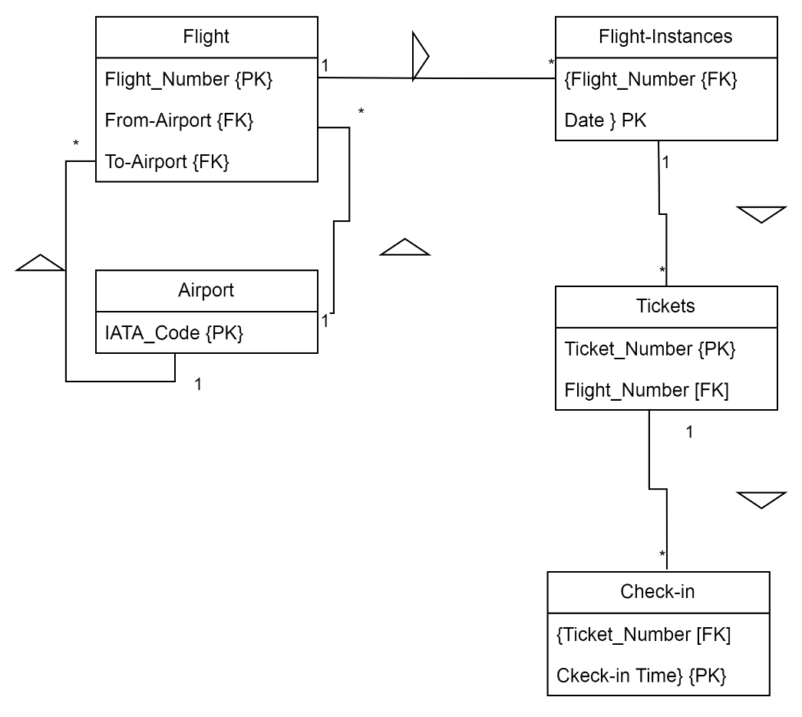
heterogeneous information integration-Phase One
FLIGHTS(flight-Number, airline, From-Airport: AIRPORTS, To-Airport: AIRPORTS, departure Time, arrivalTime, carrier)
FLIGHT_INSTANCES (Flight-Number: FLIGHTS, date)
AIRPORTS (IATA-Code, name, city, country)
TICKETS (Ticket-Number, FlightNumber: FLIGHT_INSTANCES, fare, passengersFirstName, passengersSurname, passengersGender)
CHECK-IN (Ticket-Number: TICKETS, Check-in-Time, Seat, numberOfBags)

Slide 33
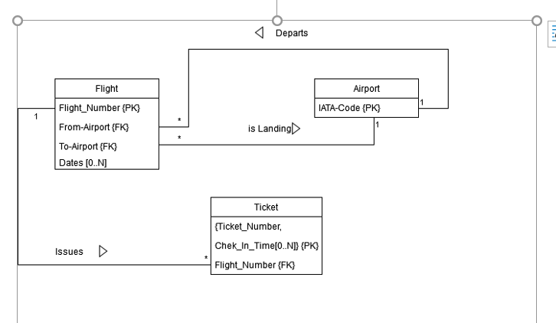
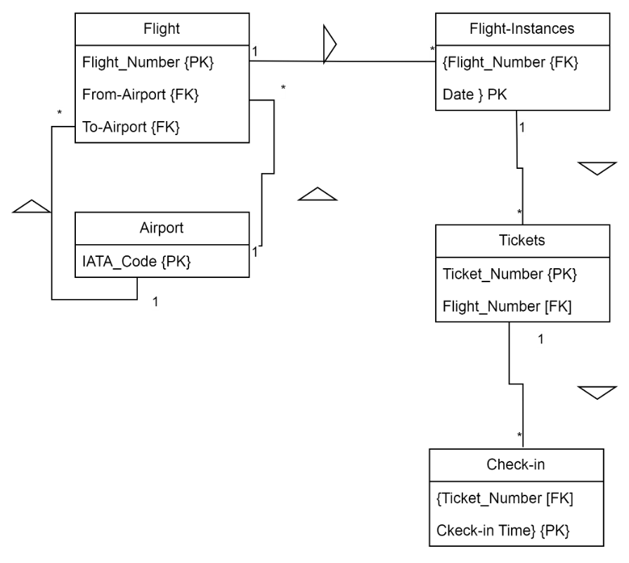
=
Heterogeneous information integration Equivalent Designs/ Models
Tutorial 2 Revie

Slide 34
Phase 2: Conceptual DWH Design
Given: (Attribute Tree1):
flight-Number → airline, From-Airport (IATA-Code), To-Airport (IATA-Code), , departure Time, arrivalTime, carrier
IATA-Code → name, city, country
Deduced:
flight-Number → airline, From-Airport (name, city, country
To-Airport (name, city, country), departure Time, arrivalTime, carrier
Given (Attribute Tree2):
flight-Number → airline, From-Airport (name, city, country
To-Airport (name, city, country), departure Time, arrivalTime, carrier
Flight-Number, date →Flight-Number, date
Deduced:
flight-Number, date →date, airline, From-Airport (name, city, country, To-Airport (name, city, country), departure Time, arrivalTime, carrier

Slide 35
Phase 2: Conceptual DWH Design

Slide 36
Phase 2: Conceptual DWH Design

Slide 37
Phase 2: Conceptual DWH Design

Slide 38
Phase 2: Conceptual DWH Design

